Slide 1
FDI in Nepal
Report on Registered company for Foreign Investment in Nepal.
All the amount written in this report is in million rupees.

Slide 2
Along with the process of liberalization in the mid-1980s, Nepal put efforts to attract FDI to fill the resources gap in private capital formation. Foreign Investment and Technology Transfer Act, 1982 was enacted to attract and utilize the foreign investment in Nepal. Subsequently, a new Foreign Investment and Technology Transfer Act, 1992 was enacted to facilitate the liberalization process of 1990s. Thereafter, Nepal became member of the World Trade Organization-WTO, Bay of Bengal Initiative for Multi-Sectoral Technical and Economic Cooperation-BIMSTEC, South Asia Free Trade Agreement-SAFTA and Multilateral Investment Guarantee Agency-MIGA. Nepal signed Bilateral Investment Protection and Promotion Agreement (BIPPA) with six countries and Double Taxation Avoidance Agreement with ten countries. Nepal has obtained access to neighboring and global markets. Investment Board Act, 2010 was enacted based on which Investment Board has been established.
The legal arrangements that govern FDI in Nepal include Foreign Investment and Technology Transfer Act (FITTA), 1992, Foreign Exchange (Regulation) Act, 1962, Investment Board Act, 2010 and Industrial Enterprises Act, 2016, Company Act, 2017, Investment Board Act, 2011, Contract Act, 2000, Arbitration Act, 1999, Income Tax Act, 2002, Labor Act, 2017, and Privatization Act, 1992. Similarly, DOI, Investment Board of Nepal (IBN) and NRB are the agencies for administration and implementation of rules and regulations related to FDI.
The FITTA defines the forms of foreign investment as (a) investment in share (equity); (b) reinvestment of the earnings derived from the clause (a) above; (c) investment made in the form of loan or loan facilities. The minimum investment required for foreign investment approval is Rs. 5 million per investor. The act also defines the technology transfer which is allowed even in the area where foreign investment is not permitted. Use of technological rights, specialization, formula, process, patent or technical know-how of foreign origin; use of any trademark of foreign ownership and acquiring any foreign technical consultancy, management and marketing service are the forms of technology transfer. However, there are some industries like cottage industries, security printing, arms and ammunition industries, among others, where foreign investments are not allowed. Furthermore, there are sector specific acts that should also be followed if the investment goes to the given specific sectors. These acts are the Electricity Act, 1992, Nepal Petroleum Act, 1983, Private Investment in Infrastructures Act, 2006, Mines and Mineral Resources Act, 1985, Bank and Financial Institutions Act, 2017, among others.

Slide 3
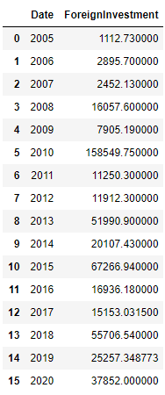
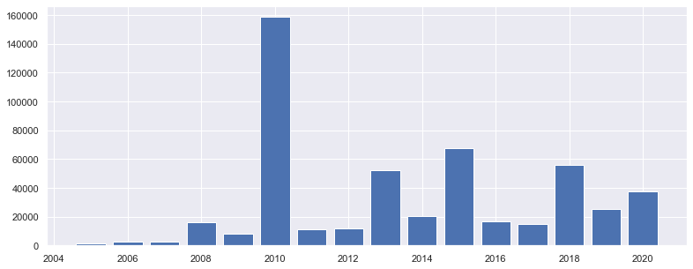
In 2010, Investment Board Act was passed because of which we can see a high surge in registration for Foreign Investment in Nepal after long time. Even though

Slide 4
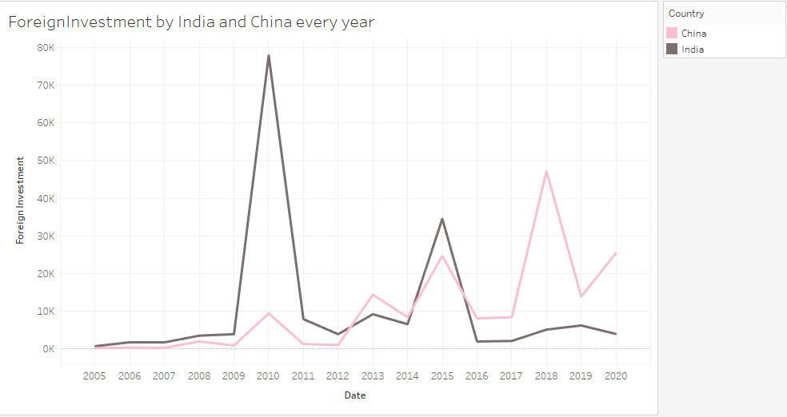
Two countries, India and China plays a major role in the Foreign Investment in Nepal. After the abolishment of Monarchy and going toward making of own constitution, we can see that India is investing heavily in Nepal. Comparing to India, Foreign Investment from China also increased but is behind the India in 2010. When the Communist Party came into power with full majority, China started investing heavily in Nepal after 2015.

Slide 5
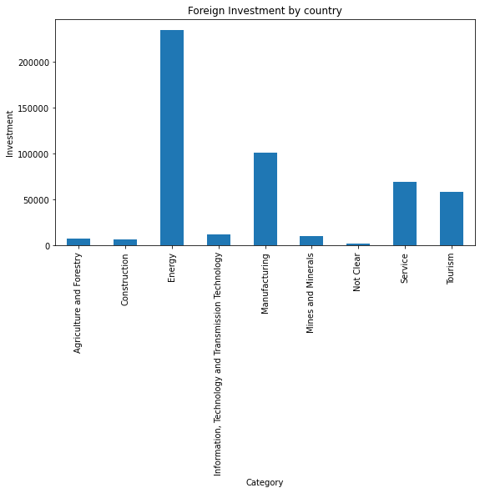
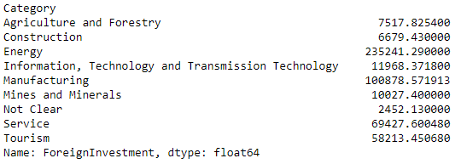
Since Nepal has the high potential for producing the Clean Energy by Hydropower, we can see that most of the investment are for Energy sector followed by Manufacturing, Service and Tourism.

Slide 6
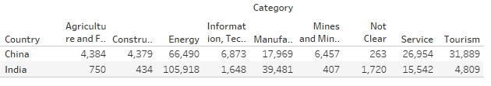
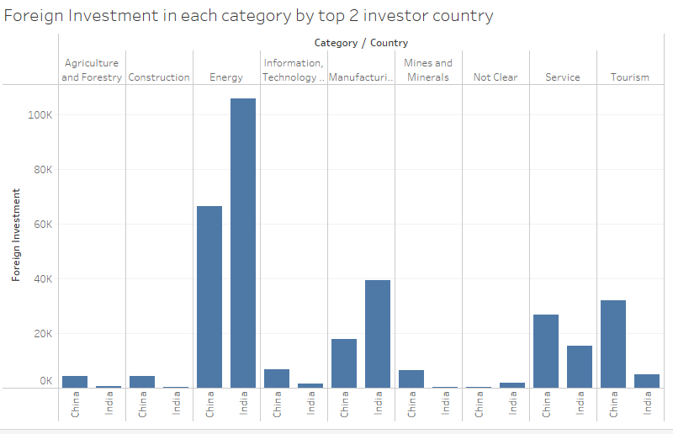
Here we can see India leads the role in highest investment in energy sector in Nepal while in categories like agriculture, mines, service and tourism China takes the lead.

Slide 7
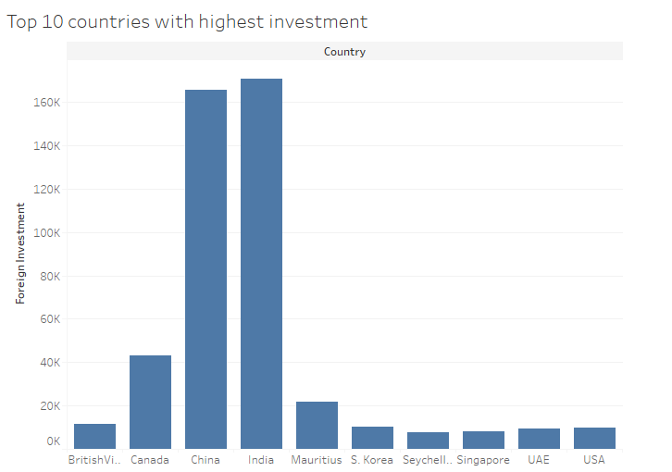
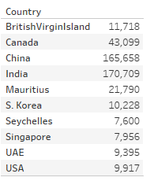
Top 10 countries with highest investment

Slide 8
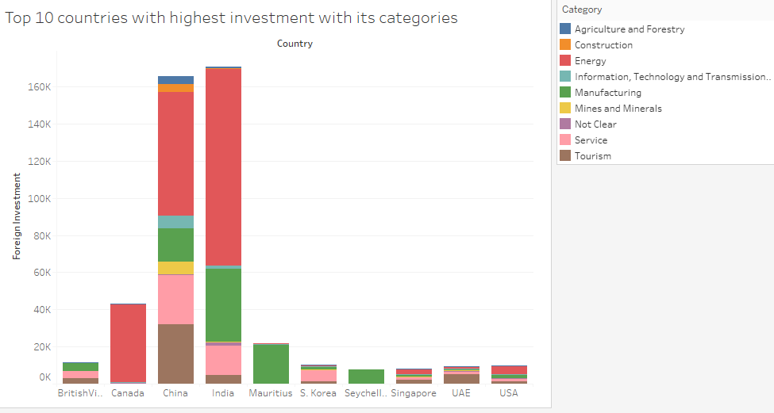
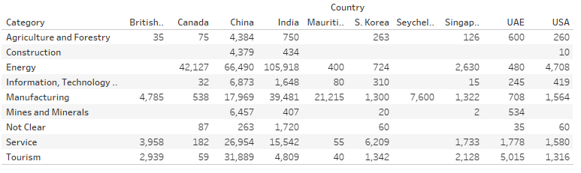
Top 10 countries with its categories.

Slide 9
Conclusion
Comparing to other countries, two of the immediate neighbors, India and china are more interested in investing in Nepal. Foreign Investment in Nepal is very low in comparison to other countries. It shares only 0.01 percent of total FDI in the world while the South Asia received 3.1 percent of total FDI inflows in 2016. We can see rise in investment after certain acts but again the FDI decreases there after. This is because of the unstable government of Nepal. Acts and Policies changes according to different government which makes Foreign Investment hesitate to invest as their investment is not secure. Even if the investment is going in upward direction the increasing rate is quite low compared to other countries. The main reason is the instability of the government and poor infrastructure. Some of the major hindrances for the FDI inflow are:
Restrictive FDI regime
Lack of clear cut and transparent sectoral policies for FDI
High tariff rates by international standards
Lack of decision-making authority with the state governments
Limited scale of export processing zones
No liberalization in exit barriers
Stringent labor laws
Financial sector reforms

